Slide 1
Project 2: Implementation of Dijkstra algorithm for a Point and Rigid Robot
This is a group project, done in teams of 2. Groups will be announced separately.
Due Date – March 6th, 11.59 PM

Slide 2
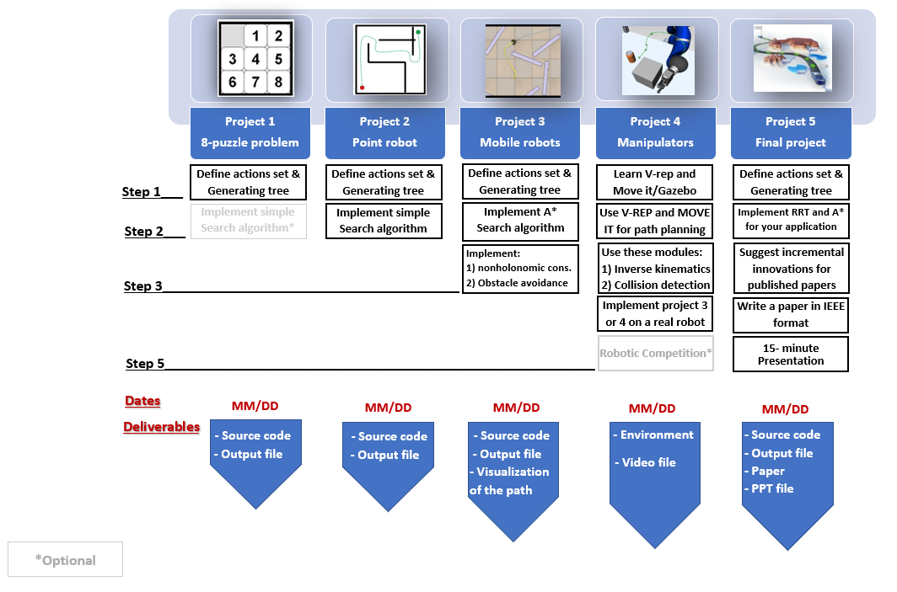

Slide 3
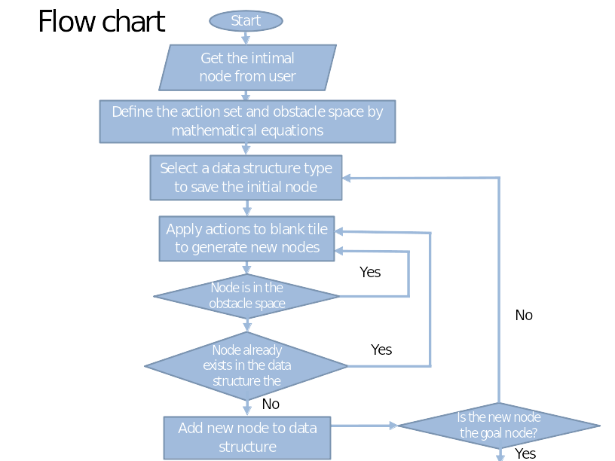
Explore the action space to generate new nodes

Slide 4
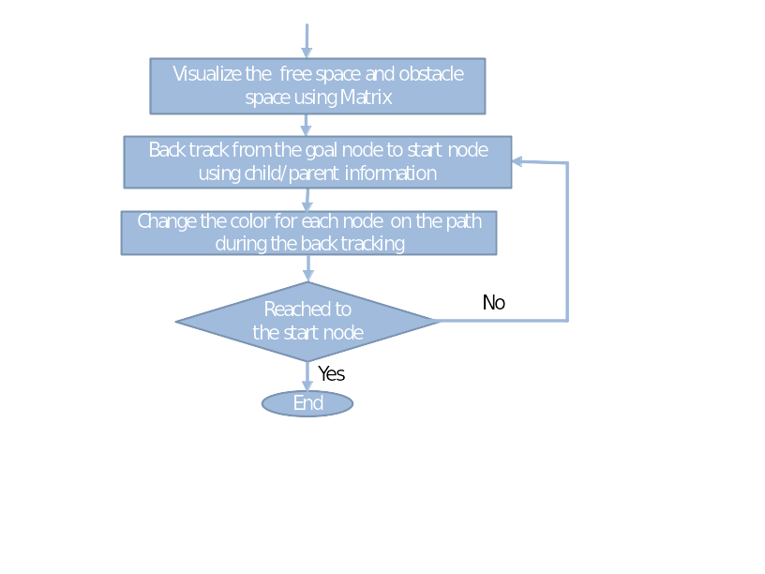

Slide 5
Project 2 Description
Your code must take following inputs from the user:
Project Assumption: Workspace is a 8 connected space, that means now you can move the robot in up, down, left, right & diagonally between up-left, up-right, down-left and down-right directions.
Point Robot | Rigid Robot
Start Point | Start point
2. Goal Point | 2. Goal point
 | 3. Robot radius
 | 4. Clearance

Slide 6
Project 2 Description
1) Check the feasibility of all inputs/outputs (if user gives start and goal nodes that are in the obstacle space they should be informed by a message and they should try again).
2) Implement Dijkstra’s Algorithm to find a path between start and end point on a given map for a point robot (radius = 0; clearance = 0) and for a rigid robot (radius = r; clearance = c)
3) Your code must output an animation of optimal path generation between start and goal point on the map. You need to show both the node exploration as well as the optimal path generated. (Some useful tools for simulation are OpenCV/Pygame/Matplotlib).

Slide 7
Step 0) Practice BFS on Trial map
Follow a similar approach as used in Project 1, to explore the nodes on the given obstacle map.
Use the 8-action space method as described in the following slides.
This exercise is for your reference. You do not need to submit any codes for this. This is not graded.

Slide 8
Step 1) Define the actions in a mathematical format
Use can use the same data structure from project 1 to store the node information. You should also store the cost2come for each node.
Write 8 subfunctions, one for each action. The output of each subfunction is the state of a new node after taking the associated action.

Slide 9
Step 2) Find mathematical representation of free space
Use Half planes and semi-algebraic models to represent the obstacle space. (Read Chapter 3: Geometric Representations and Transformations from Planning Algorithms by Steven M. LaValle)
Professor will cover this topic during the next class in details.

Slide 10
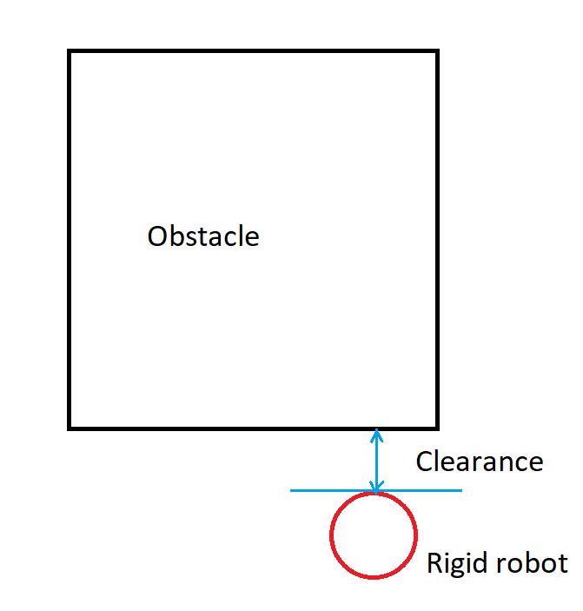
Clearance
Clearance is a maximum distance between the obstacle and the extreme point of the rigid robot.

Slide 11
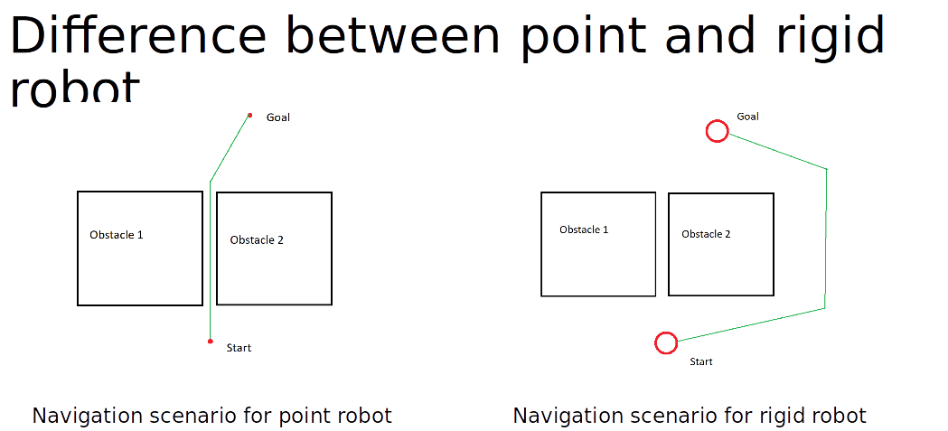

Slide 12
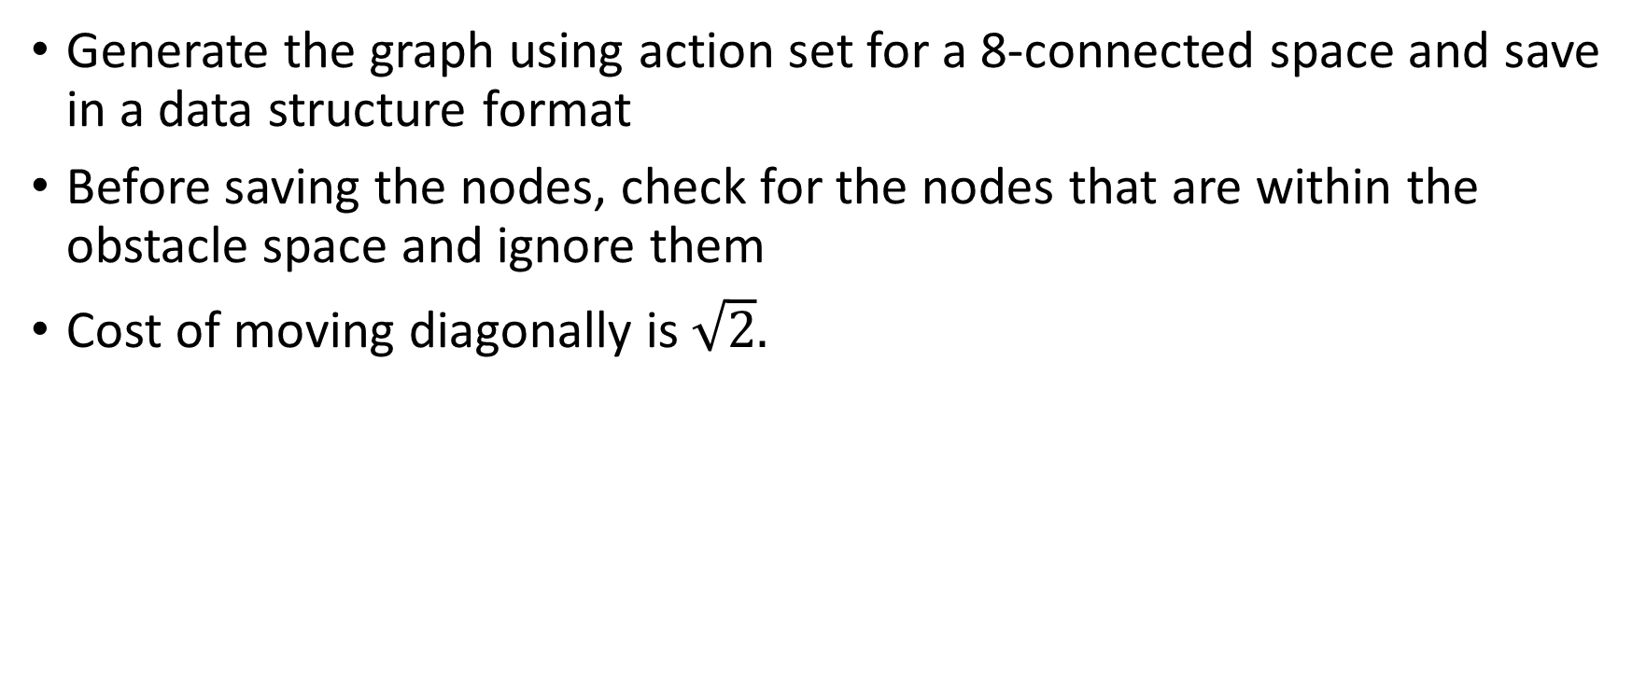
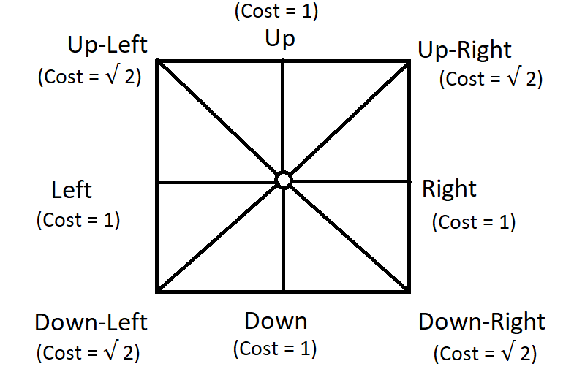
Step 3) Generate the graph

Slide 13
Step 4) Find the optimal path
Write a subfunction that compares the current node with the goal node and return TRUE if they are equal.
While generating each new node this subfunction should be called
Write a subfunction that once the goal node is reached, using the child and parent relationship, it backtracks from the goal node to initial node and outputs all the intermediate nodes.

Slide 14
Step 5) Represent the optimal path
Show optimal path generation animation between start and goal point using a simple graphical interface. You need to show both the node exploration as well as the optimal path generated.
The visualisation of (exploration and optimal path) should start only after the exploration is complete and optimal path is found.

Slide 15
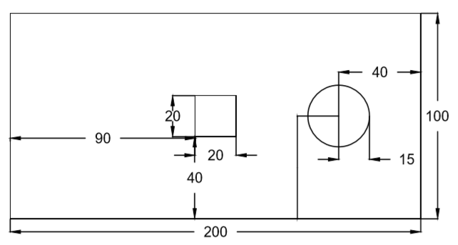
Trial Map
160
50
How to define obstacle: for square: point (x,y) is in the obstacle space if x>=90 and x<= 110 and y>=40 and y<=60
for circle: point (x,y) is in the obstacle space if (x-160)^2+(y-50)^2 < 15^2

Slide 16
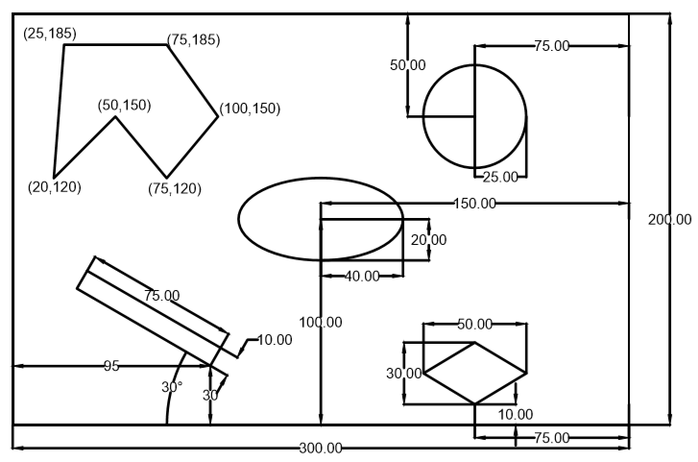
Final Map (towards submission)

Slide 17
Deliverables
Deliverables:
ReadMe.txt (Describing how to run the code in a txt format)
Source files for
Dijkstra_point.py
Dijkstra_rigid.py
3. GitHub repository link in the URL submission box (One repository link with commits from both team members)

Slide 18
Submission Details
You are required to submit a zip file with the file structure as shown
proj2_groupnumber_codingLanguage
codes
readme.txt

